Slide 1
Women Workers: Austerity and Resistance
Dr. Hazel Conley
Centre for Research in Equality and Diversity
Queen Mary, University of London

Slide 2
Women and the Labour Market
Historical compromise between women’s paid work in the public sphere and unpaid work in private sphere
Has determined if women work, where they work, how long they work for, the type of employment contract they receive and the amount they are paid
The importance of the public sector both as a service provider that allows women to work and as an employer paying women to provide those services
The importance of Welfare State to subsidise low pay and job insecurity
Notes:
40% of womens jobs are in the public sector compared to 15% of Men’s (TUC, 2011)

Slide 3
‘Age of Austerity’ Cameron, (2009)
“ The question is: how does government help achieve these wider aims in the age of austerity?
And the answer is: by delivering more for less.
That in turn means four big changes for government and the role of the state.
First, a return to traditional public spending control.
Second, a new culture of thrift in government.
Third, curing our big social problems, not just treating them.
And fourth, imagination and innovation as we harness the opportunities of technology to transform the way public services are delivered.”

Slide 4
Austerity 1 (OBR, 2011:15)

Slide 5
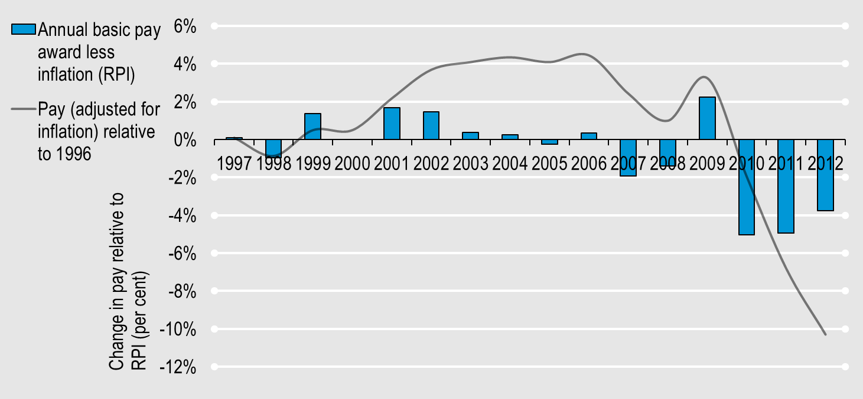
Austerity 2 (Kenway et al. 2012: 13)

Slide 6
Austerity Measures and Women in the UK
Emergency Budget 2010
Budget cuts to government departments between 25-40%
Public sector pay freeze for 2 years on those earning £21k+
Flat rate increase of £250 for those earning below £21k
Child welfare benefits frozen
Sure start benefits limited to 1 child
Removal of income support for lone parents when youngest child reaches 5
Child tax credits reduced
Moving from RPI to CPI to ‘uprate’ benefits
Increase in State Pension Age (grandmothers less likely to be available for childcare)
Changes to DLA carers allowance
Health in Pregnancy grant removed

Slide 7
Impact on Women
The government did not publish an equality impact assessment required under the gender equality duty
“Low income mothers, who are the managers and shock-absorbers of poverty, will be among the main losers. Women from black and minority ethnic groups will be particularly hard hit, as 40 per cent of them live in poor households” (WBG 2010)
Yvette Cooper, the Shadow Home Secretary, produced research to suggest that £6bn of the £8bn generated by the emergency budget in one year would come from women’s income
TUC (2011) female lone parents will lose an average of 18.5% of their income

Slide 8
Impact 2
72% of the public sector jobs affected by the public sector pay freeze are held by women
The Office of Budgetary Responsibility have upwardly revised the figure of public sector job losses to 710,000 by 2017 (77% increase in 8 mnths)
Female unemployment has reached its highest level for 23 years (WBG, 2012)
The loss of women’s jobs in the public sector will inevitably increase the gender pay gap in the UK
Rising costs of childcare
Rise in incidence of domestic violence, but refuges closing (Towers and Walby, 2012)
Midwifery services are ‘teetering on the brink’ (RCM, 2010)

Slide 9
Resistance – Trade Unions
Industrial Action on pensions – gender neutral?
TUC and union campaigns, research and publications
Trade unions equality and the law

Slide 10
Resistance - ‘New’ Actors
Fawcett Society legal challenge to the emergency budget (Conley, 2012 forthcoming)
Government was bound by the Gender Equality Duty to have ‘due regard’ to the impact on women but had not done so.
Judicial review was refused because it would cause:
“problems of a significant order for the certainty which the public and corporate world (individual and foreign) is entitled to have in the budgetary affairs of the United Kingdom” Mr. Justice Ouseley (s 18).

Slide 11
Conclusions
Coalition government is the ‘most female-unfriendly in living memory’ Brendan Barber
Trade union support is clear but action muted
‘New’ Actors have started to step into the breach, but have limited power
A women’s best friend is still her trade union – but trade unions need to re-think their strategy to challenge the disaster that is starting to unfold for hundreds of thousands of women

